Slide 1
Lecture9
图形用户界面
的设计与实现

Slide 2
提纲
用户自定义成分
GUI标准组件
Java事件处理
布局设计
容器

Slide 3
AWT APIs
java.awt
java.awt.accessibility
java.awt.color
java.awt.datatransfer
java.awt.dnd
java.awt.event
java.awt.font
java.awt.geom
java.awt.image
java.awt.peer
java.awt.print
javax.swing

Slide 4
用户自定义成分
AWT(Abstract Windowing Toolkit) 包
  Color, Font, FontMetrics , Component, Graphics , Polygon, Toolkit
坐标（0, 0）
(width-1, height-1)
绘制图形 P185 例7-1
显示文字 P187 例7-2
控制颜色 P189 例7-3
显示图像 P190 例7-4

Slide 5
AWT 标准组件(1)
Event
Obiect
CheckboxGroup
FlowLayout
Color
Graphics
Font
Component
Button
Lable
Choice
Scrollbar
Container
List
Canvas
Checkbox
TextComponent
Window
panel
TextField
Dialog
Frame
TextArea
Applet
FileDialog

Slide 6
AWT 标准组件(2)
组件
  Button, Checkbox, Choice, List, Menu, TextField
  这些控件产生ACTION_EVENT, 程序会响应该事件
  其它控件: Scrollbar and TextArea
  Canvas
  Lable
容器
  类型:Panel,ScrollPane,window
  常见的容器:Dialog, FileDialog ,Applet, Frame

Slide 7
AWT 标准组件(3)
布局类
  选择预先定义好的组件排放格式
事件处理类
  封装用户与应用程序交互的信息
其它组件类
  Size and Shape Class
  Color Class
  Image Class
  Font and FontMetrics Class
  Graphics

Slide 8
AWT 标准组件(4)

Slide 9
AWT事件模型
用户发出命令，会引发一个系统预先定义好的事件
用户程序需要编制代码定义每个特定事件发生时程序应做出如何响应
图形用户界面的每个可能产生事件的组件被称为事件源，不同事件源上发生的事件的种类不同
事件源必须注册给能够处理该事件源上那种类型事件的监听者
监听者可以是包容事件源的容器，也可以是另外的对象
监听者具有监听和处理某类事件的功能，是因为它实现了相关的接口。这些接口内部包含了若干处理相关事件的抽象方法，监听者需要写出具体的方法体

Slide 10
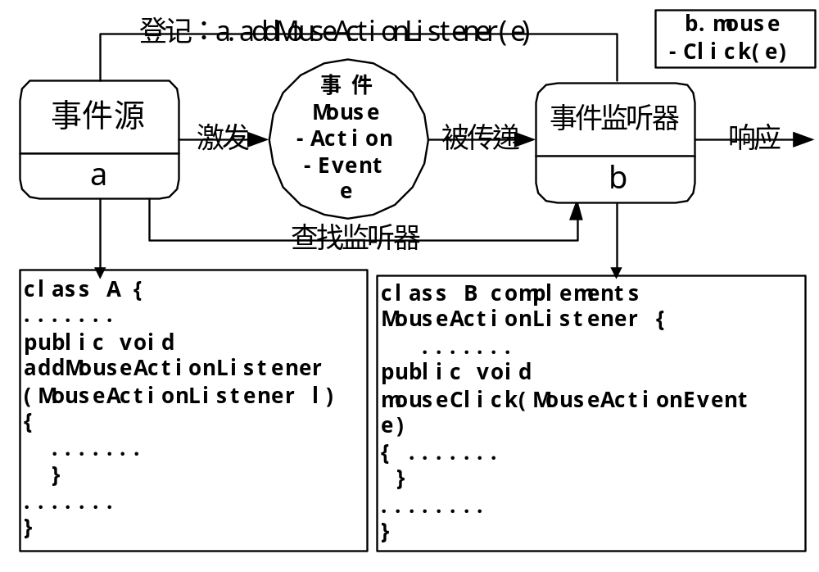
委托事件模型（1）

Slide 11
委托事件模型（2）
XEvevt
Source1
XEvent1
Stimulus1
XEvevt
Listener1
XEvent2
YEvevt
Source1
YEvent1
Stimulus2
Xevevt and YEvevnt
Listener1

Slide 12
AWT事件类
java.awt.AWTEvent 是所有 AWT 事件(a subclass of java.util.EventObject)的根
AWTEvent 的子类有: ActionEvent, WindowEvent, ItemEvent, KeyEvent, MouseEvent, TextEvent, 等
java.awt.AWTEvent 是所有 AWT 事件(a subclass of java.util.EventObject)的根
AWTEvent 的子类有: ActionEvent, WindowEvent, ItemEvent, KeyEvent, MouseEvent, TextEvent, 等

Slide 13
AWT事件接口
java.awt.event定义了11个监听者接口：
  ActionListener: Button, MenuItem, List
  WindowListener:Window
  ItemListener: Choice, List, Checkbox
  KeyListener: Component
  MouseListener: Component
  MouseMotionListener: Component
  TxetListener: TxetComponent
一个对象必须通过调用addXXXListener方法将自己注册到一个事件源上

Slide 14
AWT 组件
组件
  Button
  Checkbox
  Choice
  Dialogbox
  Frame
  Label
  List
  Menu
  Panel
  Canvas
  Slider or Scrollbar

Slide 15
组件与动作事件
标签（Label）：P197
按钮（ Button ）：P197-198
动作事件（ActionEvent）:P199
文本框与文本域（TextFeild与TextArea）: P200-203
单、复选按钮和列表（ Checkbox 、 Choice 和List ）：P203-213
滚动条（ Scrollbar ）：P213-217
画布（ Canvas ）：P217-224

Slide 16
布局组件
Common Rules
BorderLayout
CardLayout
FlowLayout
GridLayout
GridBagLayout
Customization Layout
Absolute Location

Slide 17
Common Rules(2)
  Container and Layout
    Default :
    panel and applet ------ FlowLayout
    Windows ------ BorderLayout;
    Non-Default
    Container.setLayout(new CardLayout());
  When invoke Layout
    add(), remove(): directly invoke;
    layout(): indirectly invoke;
    preferredSize(), minimumSize()

Slide 18
BorderLayout
The BorderLayout contains five distinc areas: ‘North’, ‘South’, ‘East’, ‘West’ and ‘Center’
Construct Function
  public BorderLayout();
  public BorderLayout(int hqap, int vgap);
North
West
Center
East
South

Slide 19
CardLayout
The components are stacked on top of each other,like a deck of cards,so that only one component is visible at a time
Construct Function
  public Cardlayout();
  public CardLayout(int hgap, int vgap)
one
one

Slide 20
FlowLayout
If the container uses a flow layout, components are arranged in a row across the area of the container
Construct Function
  public FlowLayout();
  public FlowLayout(int align);
  public FlowLayout(int align, int hgap, int vgap)
three
one
two
four
five

Slide 21
GridLayout
This layout manager divides the area of the container into a grid of equally sized rows and columns
Construction Function
  public Gridlayout(int rows, int cols);
  public Gridlayout(int rows, int cols, int hgap, int vgap)
one
two
three
four
five
six

Slide 22
GridBagLayout
This layout manager is more flexible than a grid layout because components can be put in any cell and can span more one one row or column
Construction Function
  public GridBagLayout()
one
two
four
three

Slide 23
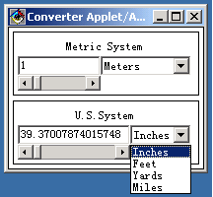
The Structure of Java GUI Program
A GUI program usually contain:
  setting the basic container
  setting layout manager
  adding some components
  programming interactive event handling codes
  Example ( Converter.html)

Slide 24
Example(1)
The Classes in Converter
  Converter Class: The Core of the Program, including main method, init method.
  ConversionPanel Class: Organize all Controller together.
  GridLayout Object: Manage the Component in Converter
  GridBagLayout: ConversionPanel Class use it to manage its Component

Slide 25
Example(2)
The Hierarchy of Component
A Frame
A Converter
A ConversionPanel (metricPanel)
A ConversionPanel (usaPanel)
A Choice
A Lable
A Choice
A Lable
A TextField
A Scrollar
A TextField
A Scrollar

Slide 26
Example(3)
The Displaying Process
  Frame draws itself
  Convert draws itself and his BoardFrame
  ConversionPanel draws itself and his BoardFrame
  Label etc. draw itself
Handling Event
  Event Object
    Event Type, Event Target Object, Time, Location, Key, and Other information about “Shift” and “Control”

Slide 27
Example(4)
    Handle Event
      Common Method handleEvent();
      Other Method Such as action();
      Parameter Event, return Boolean. If false, transit Event to higher Component, else no.
      Method handleEvent() always return super.handleEvent
    Get Input Focus
      Component can use Method requestFocus() to get input focus
      When Component get focus, method getFocus() invoked
      When Component lost focus, method lostFocus() invoked

Slide 28
Common Rules about Using Component(1)
How to add Component into Container
  Component be displayed after adding into Container
  Container is a Component too, so it can be added into other Container
  Window is the Top Container, so it could not be added into other Container
The Functions of Class Component
  Draw Functions, Such as paint() , update() and repaint()

Slide 29
Common Rules about Using Component(2)
  Handle Event Functions, such as common method handleEvent() and others
  Font Control and Color Control, such as setForeground(), getForeground(), setBackground() and getBackground()
  Display and Location Control. Though most control functions are in Layout, Component use preferredSize() and minimumSize()
  Handle image. Only use Class Canvas and Container
How to change the Display features and behaviors of Component
  Using Canvas Class

Slide 30
Button
Construct Function
  public Button()
  public Button(String Label)
Method
  public String getLabel()
  public void setLabel(String label)
  protected String paramString()
  public void disable()
  public void enable()
  public synchronized void addNotify()
Example (ButtonExample.java)

Slide 31
Example(1)
private java.awt.Panel getContentsPane() {
if (ivjContentsPane == null) {
try { ivjContentsPane = new java.awt.Panel();
ivjContentsPane.setName("ContentsPane");
ivjContentsPane.setLayout(null);
getContentsPane().add(getButton1(), getButton1().getName());
getContentsPane().add(getButton2(), getButton2().getName());
getContentsPane().add(getButton3(), getButton3().getName());
} catch (java.lang.Throwable ivjExc) {
handleException(ivjExc); } }
return ivjContentsPane; }
……

Slide 32
Example(2)
private java.awt.Button getButton1() {//* 返回 Button1 特性值
if (ivjButton1 == null) {
try {
ivjButton1 = new java.awt.Button();
ivjButton1.setName("Button1");
ivjButton1.setBounds(15, 99, 129, 20);
ivjButton1.setLabel("Disable middle button");
} catch (java.lang.Throwable ivjExc) {
handleException(ivjExc);}
}
return ivjButton1;}
……

Slide 33
CheckBox(1)
Including two AWT Class, Checkbox Class and CheckboxGroup Class
Checkbox Construct Function
  public Checkbox();
  public Check(String label);
  public Check(String label, CheckboxGroup, boolean state)
Member methods of Checkbox Class
  public String getLabel();
  public void setLabel(String label);
  public boolean getState();
  public void setState(boolean state);
  public CheckboxGroup getCheckGroup();
  public void setCheckboxGroup(CheckboxGroup g);

Slide 34

CheckBox(2)
  protected String paramString();
  public synchronized void assNotify();
Constuct Funtion of CheckboxGroup
  public CheckboxGrouP();
Member Methods of CheckboxGroup Class
  public Checkbox getCurrent();
  public String toString();
  public synchronized void setCurrent(Checkbox t);
Example(CheckboxExample.java)

Slide 35
Example(1)
private java.awt.Checkbox getCheckbox1() {
if (ivjCheckbox1 == null) {
try { ivjCheckbox1 = new java.awt.Checkbox();
ivjCheckbox1.setName("Checkbox1");
ivjCheckbox1.setBounds(37, 45, 84, 20);
ivjCheckbox1.setLabel("Checkbox1");
} catch (java.lang.Throwable ivjExc) {
handleException(ivjExc); } }
return ivjCheckbox1; }
……

Slide 36
Example(2)
private java.awt.Checkbox getCheckbox4() {
if (ivjCheckbox4 == null) {
try { ivjCheckbox4 = new java.awt.Checkbox();
ivjCheckbox4.setName("Checkbox4");
ivjCheckbox4.setCheckboxGroup(ivjCheckboxGroup1);
ivjCheckbox4.setBounds(203, 45, 84, 20);
ivjCheckbox4.setLabel("Checkbox4"); } catch (java.lang.Throwable ivjExc) {
handleException(ivjExc); } }
return ivjCheckbox4;}
……

Slide 37
Choice
Another name pop up list.
Construct Function of Choice
  public Choice();
Member methods of Choice
  public int countItems();
  public String getItem(int index);
  public synchronized void addItem(String item);
  public String getSelectdItem();
  public int getSelectdIndex();
  public synchronized void select(int pos);
  public void select(string str);
  protected String paramString();
  public synchronized void addNotify();
Example

Slide 38
Example(1)
public class MyChoice extends Applet {
private Choice choiceButton;
private TextField t; private Font f;
public void init(){
choiceButton = new Choice();
t=new TextField(“Sample Text”,16); t.setEditable(false);
choiceButton.addItem(“TimesRoman”);
choiceButton.addItem(“Courier”);
choiceButton.addItem(“Helvetica”);
f=new Font(choiceButton.getItem(0), Font.PLAIN,14);
t.setFont(f);
add(choiceButton); add(t); }
……

Slide 39
Dialogbox
Dialogbox depends on Frame.
Construct Function of Class Dialogbox
  public Dialog(Frame parent, boolean modal)
  public Dialog(Frame parent, String title, boolean modal)
Member Methods of Class Dialog
  publilc boolean isModal();
  public String getTitle();
  public void setTitle(String title);
  public boolean isResizeable();
  public void setResizable(boolean resizeavle);
  public String paramString();
  public synchronized vid addNotify();

Slide 40
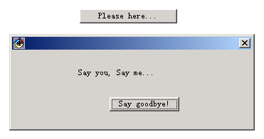
Example
  Example (DialogExample.java)

Slide 41
Frame
Construct Function
  public Frame();
  public Frame(String title);
Member Methods of Class Frame
  public String getTitle();
  public void setTitle(String title);
  public Image getIconImage();
  public Image setIconImage();
  public MenuBar getMenuBar();
  public synchronized void setMenuBar(menuBar menubat);
  public synchronized void remove(MenuComponent m);
  public boolean isResizable();
  public void setResiable(boolean resizable);

Slide 42
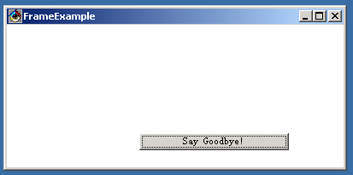
Example
    public void setCursor(Image img);
    protected String paramString();
    public synchronized void addNotify();
  Example (FrameExample.java)

Slide 43
Label
Constuct Funtion
  public Label();
  public Label(String label);
  public Label(String label, int alignment);
Member Methods
  public int getAlignment();
  public void setAlignment(int alignment);
  public String getText();
  public void setText(String Label);
  protected String paramString();
  public synchronized void addNotify();

Slide 44
List(1)
Construct Function
  public List();
  public List(int rows, boolean multipleSelections);
Member Function
  public int countItems();
  public String getItem(int index);
  public synchronized void addItem(String item);
  public synchronized void clear();
  public synchronized void delItem(int position);
  public synchronized void delItem(int start, int end);
  public synchronized int getSelectedIndex();
  public synchronized int[] getSelectedIndexs();

Slide 45
List(2)
    public synchronized String getSelectedItem();
    public synchronized String[] getSelectedItems();
    public synchronized void select(int index);
    public synchronized void deselect(int index);
    public synchronized boolean isSelected(int index);
    public int getRows();
    public boolean allowsMultipleSelections();
    public void setMultiSelection(boolean v);
    public int getVisibleIndex();
    public void makeVisible(it Index);
    public Dimension preferredSize(int rows);
    public Dimension minimumSize(int rows);
    public Dimension minimumSize();
    protected String paramString();

Slide 46
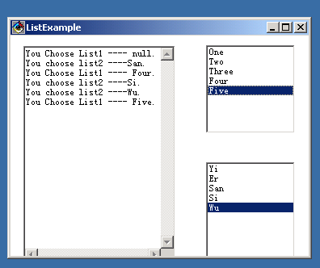
List(3)
    public synchronized void addNotify();
    public synchronized void removeNotify();
  Example(ListExample.java)

Slide 47
Menu(1)
AWT provides four classes to support menu.
MenuItem
  Construct Function: public MenuItem(String label);
  Member Function:
    public String getLabel();
    public void setLabel(String label);
    public boolean isEnabled();
    public void enable();
    public void enable(boolean cond);
    public void disable();
    protected String paramString();
    public synchronized void addNotify();

Slide 48
Menu(2)
CheckboxMenuItem
  Construct Function: public CheckboxMenuItem(String label);
  Member Method:
    public boolean getState();
    public void setState(boolean t);
    protected String paramString();
    public synchronized void addNotify();
Menu
  Construct Function:
    public Menu(String label);
    public Menu(String label, boolean tearOff);

Slide 49
Menu(3)
  Member Method:
    public boolean isTearOff();
    public int countItems();
    public MenuItem getItem(int index);
    public void add(String label);
    public synchronized MenuItem add(MenuItem mi);
    public void addSeparator();
    public synchronized void remove(int index);
    public synchronized void remove(MenuComponent item);
    public synchronized void addNotify();

Slide 50
Menu(4)
MenuBar
  Construct Function:
    public MenuBar();
  Member Method:
    public void removeNotify();
    public Menu getHelpMenu();
    public synchronized void setHelpMenu(Menu m);
    public synchronized Menu add(Menu m);
    public synchronized void remove(int index);
    public synchronized void remove(MenuComponent m);
    public int countMenus();
    public Menu getMenu(int i);
    public synchronized void addNotify();

Slide 51
Panel
Panel is Common Container. And it can load Component.
Construct Function
  public Panel();
  public Panel(LayoutManager layout);
Member Methods
  public synchronized void addNotify();

Slide 52
Canvas
Canvas couldn’t do anything . Only it support to customization Component.
Construct Function
  public Canvas();
Member Methods
  public void paint(Graphics g);
  public synchronized void addNotify();

Slide 53
Slider or Scrollbar(1)
It have two uses, one is Slider, another is Scrollbar.
Construct Function
  public Scrollbar();
  public Scrollbar(int orientation);
  public Scrollbar(int orientation, int value, int visible, int minimum, int maximum);
Member Methods
  public int getOrientation();
  public int getValue();
  public void setValue(int value);
  public int getMinimum();
  public int getMaximum();
  public int getVisible();

Slide 54
Slider or Scrollbar(2)
  public void setValues(int value, int visible, int minimum, int maximum);
  protected String paramString();
  public synchronized void addNotify();
Parameters
  int orientation: Scrollbar.HORIZONTAL or Scrollbar.VERTICAL;
  int value: the initial value of Scrollbar;
  int visible: the size of pixel;
  int minimum: the min value of Scrollbar;
  int maximum: the max value of Scrollbar;

Slide 55
TextArea and TextField
TextArea Class
  Construct Function
    Public TextArea();
    Public TextArea(int rows, int cols);
    Public TextArea(String text);
    Public TextArea(String text, int rows, int cols)
  Member Methods
TextComponent
TextField

